Slide 1
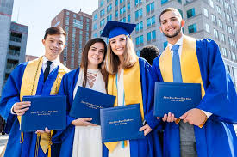
WELCOME TO THE FINAL SENIOR MEETING OF JAGFEST!
Senior Remind?
Senior Pictures?
Senior Parking?
Yearbook Ads?
Cap & Gown?
Grad Fee?
SAT/ACT?
Mid-Year Graduation?
June Graduation?
Want a FREE Senior Shirt?
Mr. Remaley (Teacher & Senior Class Advisor)
and
Mr. Mares (Principal)

Slide 2
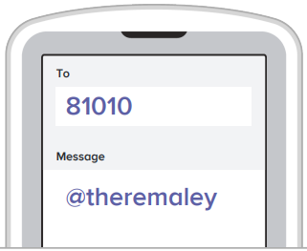
Senior Remind
The BEST way to stay connected and up to date on everything Senior related! Get your phone out now!
2-ways to sign up:
1. If you are using the Remind
App then enter class code:
@theremaley
2. Just want a text message then
text the message: @theremaley
to the number: 81010

Slide 3
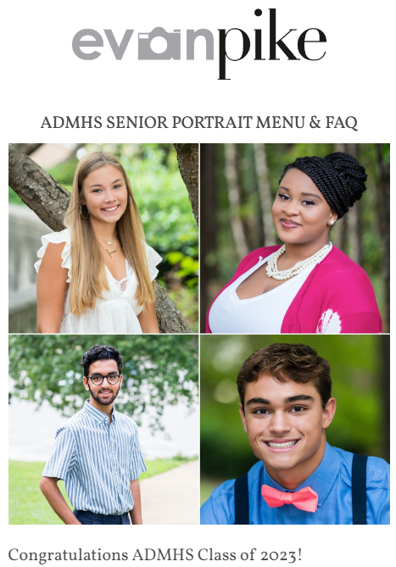
Senior Portraits
Have you gotten your Senior Portraits done?
We are once again using Evan Pike Photography
Go to admhsseniors.com and sign up TODAY!

Slide 4
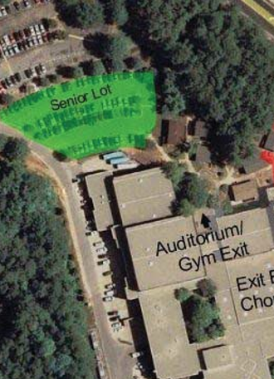
Senior Lot Parking
The Senior Lot is still in the same place, however parking is FIRST COME FIRST SERVE!
Rules to park in the Senior Lot:
1. You must have a Parking Tag
displayed! ( tag: S### )
2. You CANNOT park in the FIRST
TWO ROWS closest to the Lower
Gym OR the row facing Jag
Stadium! Those are for Staff!

Slide 5
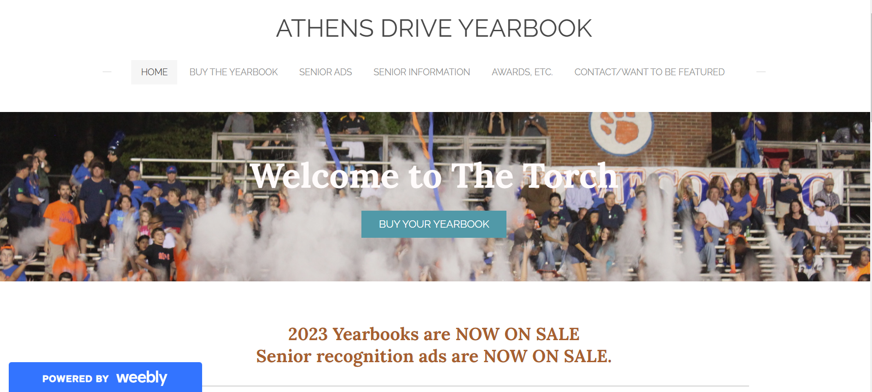
Yearbook Ads
Go to the Athens website and scroll down to find the Yearbook link under QUICK LINKS
Deadline is the end of October!

Slide 6
Cap & Gown
You will need to get your own Cap & Gown and you have 2 options:
Borrow one from a former Grad (and then buy a ‘23 tassel)
Purchase one from Jostens (info given on October 18 in Drive-Time!

Slide 7
Graduation Fee
EVERYONE has to pay the Grad Fee ($60)
It is a WCPSS thing, not just an Athens thing!
Must be paid prior to Graduation
You can pay online through the Athens website (click PARENTS and then Online Payment System
Wait for the Grad Fee to post to your PowerSchool

Slide 8
SAT & ACT
Collegebound?
If you need to take the SAT or ACT for college admissions then you must take the Tests-
No later than the October administration for Early Action/Early Decision applications
November or December administration for Regular Action/Regular Decision applications
Need help preparing for these tests? Check out the Athens exclusive SAT/ACT Prep Course
(info on the Athens website homepage)d

Slide 9
Mid-Year Graduation:
February 2
@ 5pm in the Auditorium

Slide 10
June Graduation:
June 10
@ 12pm at the Raleigh
Convention Center

Slide 11
Final Thoughts
Do you have any questions?
We will be with you EVERY STEP of the way to Graduation!
You can find me in room 2618 or email me!
cremaley@wcpss.net
Free Lunch in the Senior Lot, paint the Rock, sign the Senior Banner outside the Gym Lobby Entrance, play a game of Knockout in the Gym, or Volleyball in the sand court, more games in the outdoor basketball court, and take care of Lunch Passes & Parking in the Main Office

Slide 12
FREE Senior Shirt!
SMALLS & MEDIUMS
to the left of the screen
LARGE & X-LARGE
to the right of the screen

